Slide 1
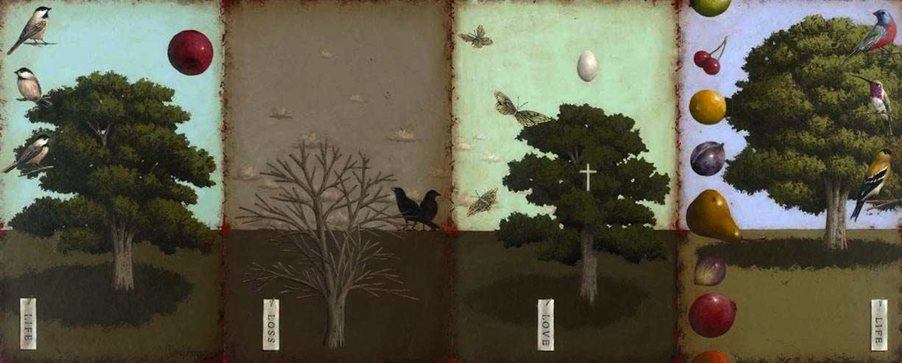
Scripture Memory – Key to Transformation
The Navigators - Multiply - October 2020

Slide 2
A Memorable, Pass-on-able Tool

Slide 3
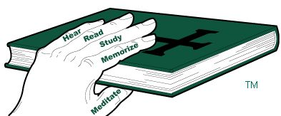
Keeping Your Grip On God’s Word

Slide 5
THE WHY

Slide 6
THE WHY
Intimacy with God
2 Corinthians 3:18 “…we all, who with unveiled faces contemplate* the Lord’s glory, are being transformed into his image with ever-increasing glory…

Slide 7
THE WHY
Intimacy
2 Corinthians 3:18 “…we all, who with unveiled faces contemplate* the Lord’s glory, are being transformed into his image with ever-increasing glory…
Ecstasy – The Majesty of Losing Yourself in the Mind and Heart of God
Psalm 126: “When the Lord restored the fortunes of Zion, we were like those who dreamed. Our mouths were filled with laughter, our tongues with songs of joy…”

Slide 8
THE WHY
Intimacy
2 Corinthians 3:18 “…we all, who with unveiled faces contemplate* the Lord’s glory, are being transformed into his image with ever-increasing glory…
Ecstasy
The sheer majesty of losing yourself in the mind and heart of God
Psalm 126: “When the Lord restored the fortunes of Zion, we were like those who dreamed. Our mouths were filled with laughter, our tongues with songs of joy…”
Fruitfulness
This is how to multiply! Regular abiding leads to a 200% increase in evangelism!
“Ministry is either an overflow, or an idolatry.” - theologian Susan Nacorda Stang
“If you remain in me and I in you, you will bear much fruit; apart from me you can do nothing.” – John 15:5

Slide 9
Intimacy → Ecstasy → Fruitfulness

Slide 10
THE HOW Three Simple Steps

Slide 11
Three Simple Steps
Get a System
Topical Memory System
7 Days of Hope-Filled Promises
Pandemic Psalms
Top 100
Find a Friend
Ecclesiastes 4:9-10 says, “Two are better than one, because they have a good return for their labor: If either of them falls down, one can help the other up. But pity anyone who falls and has no one to help them up.”
Set a Goal

Slide 12
A Goal-setting Guideline

Slide 13
A Goal-setting Guideline God’s Way

Slide 14
A Goal-setting Guideline The Way of The Enemy

Slide 15
THE WHAT Six Key Principles

Slide 16
Practice the 6 Principles with This Verse
Trust: Ps 56:3
“When I am afraid, I put my trust in you.”
Ps 56:3

Slide 17
Six Key Principles
Context is King: read and understand the surrounding context.

Slide 18
Six Key Principles
Context is King: read and understand the surrounding context.
Time and Friction: tear it apart, word for word

Slide 19
Six Key Principles
Context is King: read and understand the surrounding context.
Time and Friction: tear it apart, word for word
Building Blocks: phrase by phrase, reciting Topic: Reference: Verse: Reference. You must go slow to go fast!

Slide 20
Six Key Principles
Context is King: read and understand the surrounding context.
Time and Friction: tear it apart, word for word
Building Blocks: phrase by phrase, reciting Topic: Reference: Verse: Reference. You must go slow to go fast!
Word Perfect: eliminates later doubt and assures long-term excellence.

Slide 21
Six Key Principles
Context is King: read and understand the surrounding context.
Time and Friction: tear it apart, word for word
Building Blocks: phrase by phrase, reciting Topic: Reference: Verse: Reference. You must go slow to go fast!
Word Perfect: eliminates later doubt and assures long-term excellence.
Review, review, review: So easy to memorize, so hard to review!

Slide 22
Six Key Principles
Context is King: read and understand the surrounding context.
Time and Friction: tear it apart, word for word
Building Blocks: phrase by phrase, reciting Topic: Reference: Verse: Reference. You must go slow to go fast!
Word Perfect: eliminates later doubt and assures long-term excellence.
Review, review, review: So easy to memorize, so hard to review!
Embody it: Live it out, obey. “Blessed rather are those who hear the word of God and keep it!” - Jesus

Slide 23
Other Tips for Successful and Deep Scripture Memory
Listen to it: Read (or better, have your friend read) your passage into your Voice Memo app and listen to it whenever you can as you commute, walk, cook, or wait for something. Redeem the time! Challenge yourself!
50 Times First: Read the passage you want to memorize 50 times aloud, with great emphasis. Then, and only then, start to memorize it. This helps with memorization, understanding, and retention.
Pray the Scripture: Make whatever you’re memorizing central to that week’s prayers you pray for others (either in private, or with and for others)

Slide 24
Small Group Questions
What Scripture Memory methods or tips for were new for you, and you want to try?
What would you be excited to memorize from God’s Word and why?
With the last minute, recite Psalm 56:3, in the way that was taught (Topic, Reference, Verse, Reference)

Slide 25
Do the “One-Month Challenge”
Find a Scripture Memory partner and do the “One-Month Challenge”
Goal: Memorize 1 or 2 verses a week for four weeks, with a friend.
Sample text/email: “Hey, I really want to go deeper in my relationship with God this coming month, and want to try memorizing some Scripture verses to help with that. I’m thinking 1-2 a week for four weeks. Want to join me?”

